Slide 1

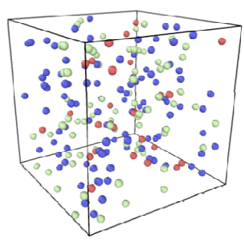

Spatial Cell Modeling
http://hexb.in/sticker.html
HIV cross-sectional incidence estimation

